Slide 1
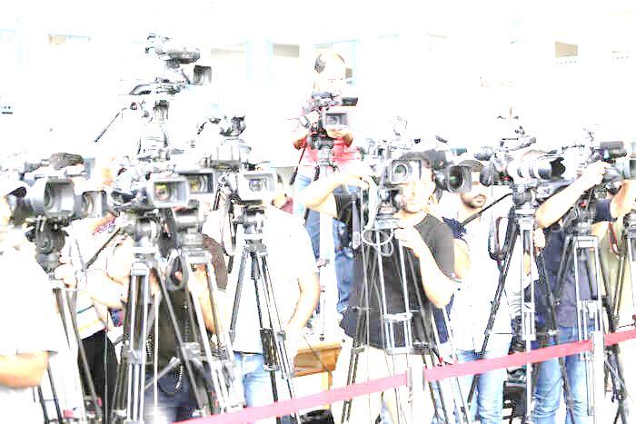


King County Superior Court
Media Training
Aug. 1, 2019

Slide 2

Why we are here
(contrast and compare!)
Q13:
Why did youth jail refuse to book suspected teen gang member found in car with guns?
KING 5
Burien police frustrated by denied booking for alleged teen gang member
The difference between facts and things that feel like facts.
We have an opportunity to educate and explain.
Q13 version
https://q13fox.com/2018/09/25/why-did-youth-jail-refuse-to-book-suspected-teen-gang-member-found-in-car-with-guns/
KING 5 version
https://www.king5.com/article/news/local/burien-police-frustrated-by-denied-booking-for-alleged-teen-gang-member/281-598163857

Slide 3








Who is “the Media”?

Slide 4
What is a reporter’s job?
Get up to speed on issues quickly
Get as much information as possible
Have a genuine understanding of the issue (sometimes)
Determine how an issue will affect viewers, listeners, readers, consumers
Create a dynamic story to elicit engagement and interaction
In some cases, advance a particular agenda or point of view
…. Oh, and educate… if all the above criteria is met
Notes:
Every media outlet is different – KIRO tends to go with the car crashes and violence – the world is terrible.
KOMO went with the homespun happy news.
Blogs and orgs like South Seattle Emerald have a point of view
Seattle Times/ Seattle Weekly have more time to commit to stories so they may genuinely want to get more info –
Seattle Weekly reporters are young. Seattle Times Reporters have a beat – esp – the Homeless Project etc.
TV
What is there job? Sell commercials – their second job is to create content so commercials don’t slam together.
For example – the Comcast Cable case is interesting because it could be the largest consumer protection award in WA history.
(Will it make me smarter, richer or better looking?)
The Microsoft story is interesting because we are talking about pornography.
How can I sell this to viewers – what is the WIFM –
The most ridiculous I saw recently was a tweet from Mike Lindblom the transpo reporter at the Seattle Times who asked people to comment on the size of the font for signs on the new tunnel- too big, two small, just right? VOTE!

Slide 5

Pro tip!
Knowing “why” they are covering your story is as important as knowing “what” they want.
There is a difference between a legal issue and something that’s newsworthy.
Reporters don’t care so much about the legal issues at play as much as the story value.
Our challenge: getting them to report/care about the legal issues too or at least understand it well enough to provide context.
Notes:
For example – the first thing I do when I get a call is ask a lot of open ended questions then hear their buzz words and google it.

Slide 6
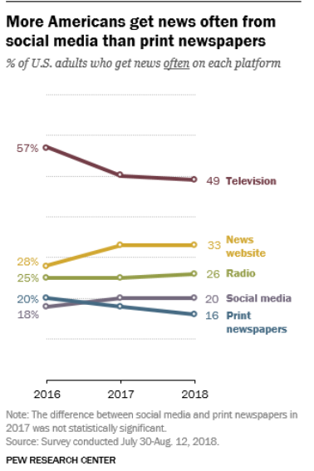
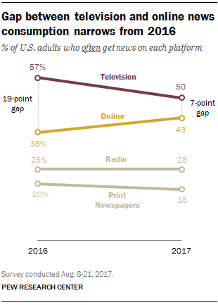
The media landscape
2018 buckets and data
What does this mean for us?
We must be flexible and work well (and consistently) across all types of media.
We must be cognizant and customize our communications style to the type of media.
Recognize that “media” will continue to evolve and we must evolve with it.
2017 buckets and data

Slide 7
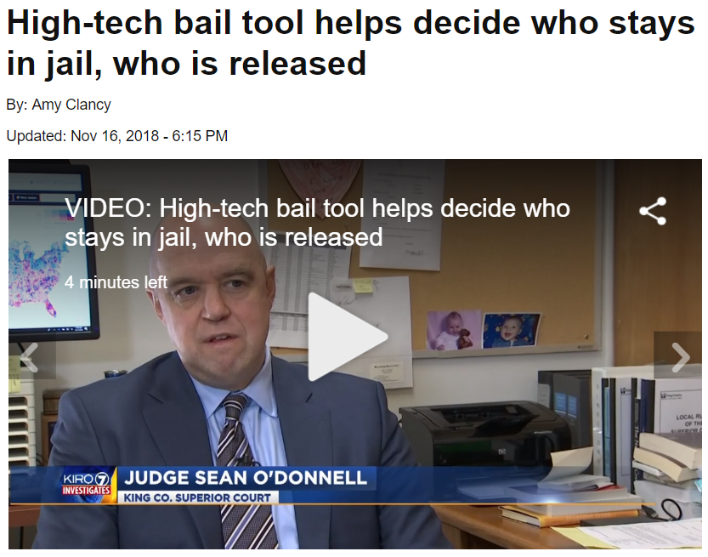
What is our job?
Be available
Be knowledgeable
Be useful
Be understandable
Be credible
Be comfortable
      Reflect our community
https://www.kiro7.com/news/local/tonight-at-5-high-tech-bail-tool-helps-decide-who-stays-in-jail-who-is-released/872942512

Slide 8
Common Judge Questions
What is the difference between “on background” and “off the record” and how do we communicate that to/with reporters?
  Off the record means I have to pretend I don’t know whatever you just told me – if someone asks to go off the record, I usually tell them not to tell me whatever it is because there’s no benefit in it for me and pretending not to know something is difficult. On background means the information can’t be directly attributed to the source who provided the information and is meant to provide the journalist with context for whatever we’re discussing. And yes, you should be clear with each reporter so you’re on the same page.
What kind of support can we expect from the PJ when a case catches fire and we can’t talk about it?
  If an issue comes up, contact the PJ and/or Communications. We will have a quick huddle to assess the situation, walk through possible scenarios and make a decision we can all live with.

Slide 9
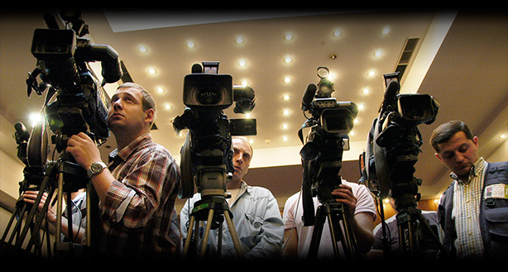
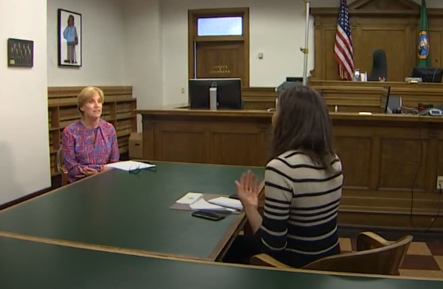
How do we do our job and let them do their job?

Slide 10

Good stories
Key messages

Slide 11





What makes a good story
Visual
Seeing is believing
Facts/data
I can prove this with data that “we” have access to.
Emotion Connection
Relevant
What is the news hook?

Slide 12
Burien story
Emotional
The police chief was mad!
Relevant
The arrest just happened and there’s been a lot of crime in Burien
Visual
We had police cars and the police chief being mad
Facts/data

Slide 13

What are “key messages”
A “key message” influences public discussion about us and our work.
It answers the question:
If there are one or two things we want people to know at the end of this interview, it is….

Slide 14
How to develop “key messages”
What do we want people to know?
What do we want people to do with that information?
Why is it important now?
What happens if they don’t know his information?
For example….
Jury recruitment
Bail reform
Community action boards Juvenile justice
Notes:
Get into groups and answer these four questions:

Slide 15
Pro tip!
Start and end EVERY INTERVIEW with your two key messages
When they ask, “Is there anything else you’d like to add?” YES! Your key messages.

Slide 16
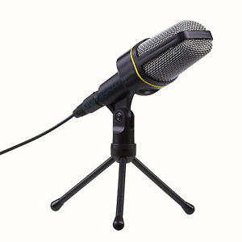
Review
Who are you talking to and why are they calling you?
    What makes your story newsworthy
Can you do your job as the “face” of the court?
    Knowledgeable
    Credible
    Comfortable
    Available
    Understandable
    Useful
Do you have the elements of a good story?
Emotion, relevance, visual, data
Do you have your key messages?

Slide 17

How to prepare for an interview
Be curious, not combative and ask…
Tell me about your story?
Why are you doing this today?
Why is this relevant now?
What is your deadline?
Who else are you talking to?
Is there a link you can send me to provide more background?
Other tips
Because we are government and justice, be prepared for any “waste”, “irresponsibility”, “careless”, “bureaucracy” questions and “ESJ” issues. Be prepared with data to counter these accusations.
Google the reporter and read their other stories to see what kind of a reporter they are.
The reporter is not your friend (not even Sara Jean Green)
Sometimes news isn’t good. Be candid and up front about what happened and merge into what we are doing to make sure it doesn’t happen again.

Slide 18
Four steps to a stronger interview
Develop and use your key message
What is your key message?
What data, stories and information do you have to support that key message?
Who, what, where, when, why, how, what are you afraid they’ll ask?
Understand and use the bridging technique.
Make information relevant to real people
Why does this matter to real people?
What makes this story interesting? (Use the next door neighbor technique.)
Develop examples that touch on the five senses.
Use appropriate energy/emotion/expressions.
Use clear and concise language
Use language the public uses
No acronyms or jargon
Use short, declarative sentences.
Break complex information into logical pieces and steps

Slide 19
How to answer questions
The bridging technique
Provide a clear and honest answer to the reporter’s question, then bridge to information we want to share. (Sarah Huckabee Sanders is the master…)
Answer the question you want asked.
Watch for traps!
Is it “A” or “B” when neither is correct.
“If” or hypothetical questions which ask us to speculate or guess. “I don’t know but what I can tell you is…”
Third party questions
“What would the Executive say about that?” Politely suggest they contact the Exec.
Silence or long pauses
Their strategy to get us to fill in the space
Do not:
Rank or compare, go off the record, over-answer questions, repeat the negative if it is in a question, DO NOT GET DEFENSIVE! Keep your cool.

Slide 20
Pro tips!
Practice out loud
Practice with a friend
Practice the questions you want them to ask
Really practice the questions you are afraid they’ll ask
Hold reporters accountable. If something is inaccurate in a published story, correct it ASAP.

Slide 21
How to work with newspapers/blogs
Ask questions and do a bit of research
Ask why they are doing the story, ask what story they want to do.
Google the reporter and the issue.
What story is in the news cycle?
Multiple interactions
The good news… newspaper reporters will call again and again to get it right.
Data, graphics, interactive
Data and data visualizations drive newspaper stories. Interactive data with slider bars, data that changes over time is the preferred way to tell the online story. NYT is very big on this.
Guest editorials
We can do these. They take a lot of work.
Pro tip!
Reporters will not send you an advance copy of their story so don’t even ask.
Corrections
Do this immediately because media uses archived newspapers for background info.
Notes:
I would love to do more data visualizations
https://www.nytimes.com/interactive/2014/11/04/upshot/senate-maps.html

Slide 22
How to work with radio
Soundbites
Short, clear, subject-verb-object (active voice) format
No parenthetical phrases
Use the right voice – no monotone
3-15 seconds
Write soundbites and key messages down, consider marking them up, keep the paper in front of you.
Preparation
Relax by humming, say blah, blah, blah, or count
Drink water (no dairy)
Find a quiet place
Use a landline, not a cell phone
If it is over skype, use headset not speakerphone
Turn off your cell phone
Stand up (don’t sit)
The producer or reporter may ask the same question multiple times.
Pro tip!
Practice soundbites out loud to make sure you don’t run out of breath.

Slide 23
How to work with television
Preparation
Take items out of your pocket to prevent jingling, turn off your cellphone.
Decide what to do with your arms and hands.
The photographer will find the best visual location, it’s his/her job. You can make suggestions.
Soundbites
Short, clear, subject-verb-object (active voice) format
Breathe between answers
3-15 seconds
If you aren’t happy with your answer, ask to do it again.
Visual
Check your teeth, hair, makeup, etc.
Wear solid colors and jewel tones, no plaids, gingham, or stripes. Ask the reporter if you look ok.
Pro tips!
Practice soundbites with a co-worker or in front of a mirror. It really, really helps.
Remember: Interviews are just electrons. You can ask for a do-over as many times as you like.

Slide 24

Thank you!
May 6, 2019

